Slide 1



Welcome to my presentation.
Made by Jason.

Slide 2
Who am i?
My Name: Jason.
My Age: 18 years old.
My Year of birth: 3th of January 2002.
My Birthday: 3th of January.

Slide 3
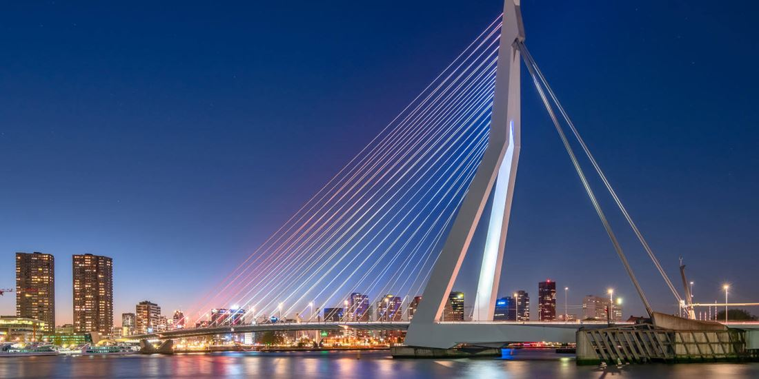
Where do i live?
I live in Rotterdam locate in South-Holland.
My family?.
Pets?

Slide 4


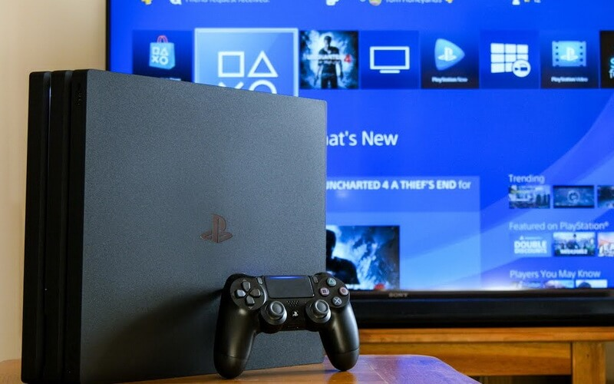

What are my hobbies?
Working.
Gamen.
Programming.

Slide 5
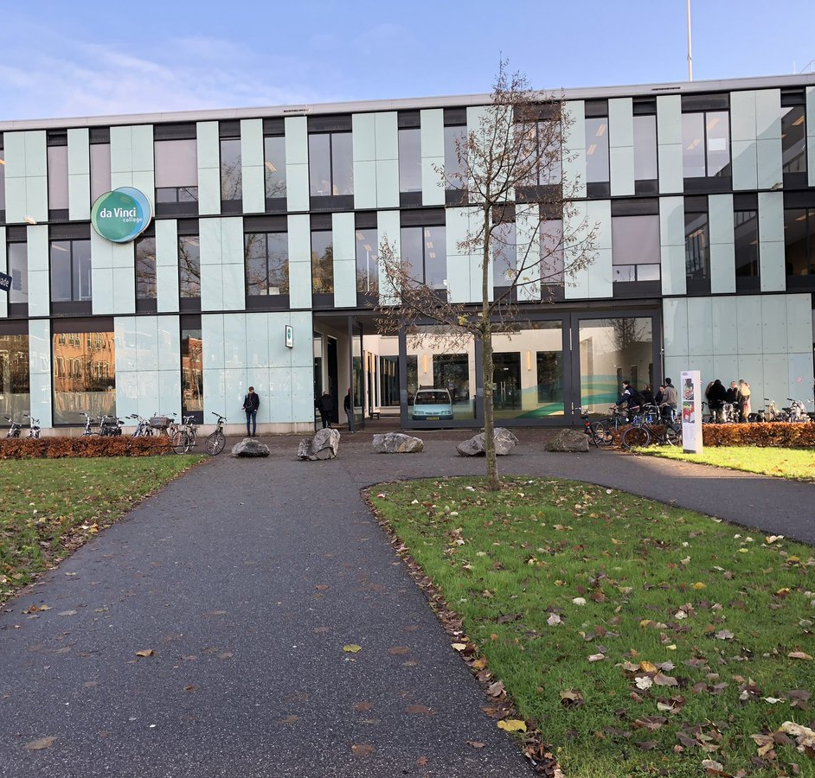
My current education?
School: Da Vinci College.
Location : Dordrecht.
Study: Mbo 4- Softwaredeveloper.

Slide 6

My personal skills and qualities?
Creative.
Motivated.

Slide 7


My main goal in life?

Slide 8

End of my presentation

